Slide 1

Socket Programming with Python
Recep YILDIRIM – recep.yildirim@sabanciuniv.edu
CS408 – Computer Networks

Slide 2
Contents
What is a Socket?
Different Types of Sockets
TCP Sockets
Socket API in Python
Code Examples
CS408 – Computer Networks

Slide 3

What is a Socket?
Sockets and the socket API
are used to send messages across a network.
They provide a form of
inter-process communication (IPC).
CS408 – Computer Networks

Slide 4

Background
Sockets have a long history. Their use originated with ARPANET in 1971 and later became an API in the Berkeley Software Distribution (BSD) operating system released in 1983 called Berkeley sockets.
CS408 – Computer Networks

Slide 5

Different Types of Sockets
UDP Sockets
TCP Sockets
Web Sockets
.
.
.
CS408 – Computer Networks

Slide 6
TCP Sockets
Is reliable: Packets dropped in the network are detected and retransmitted by the sender
Has in-order data delivery: Data is read by your application in the order it was written by the sender.
CS408 – Computer Networks

Slide 7
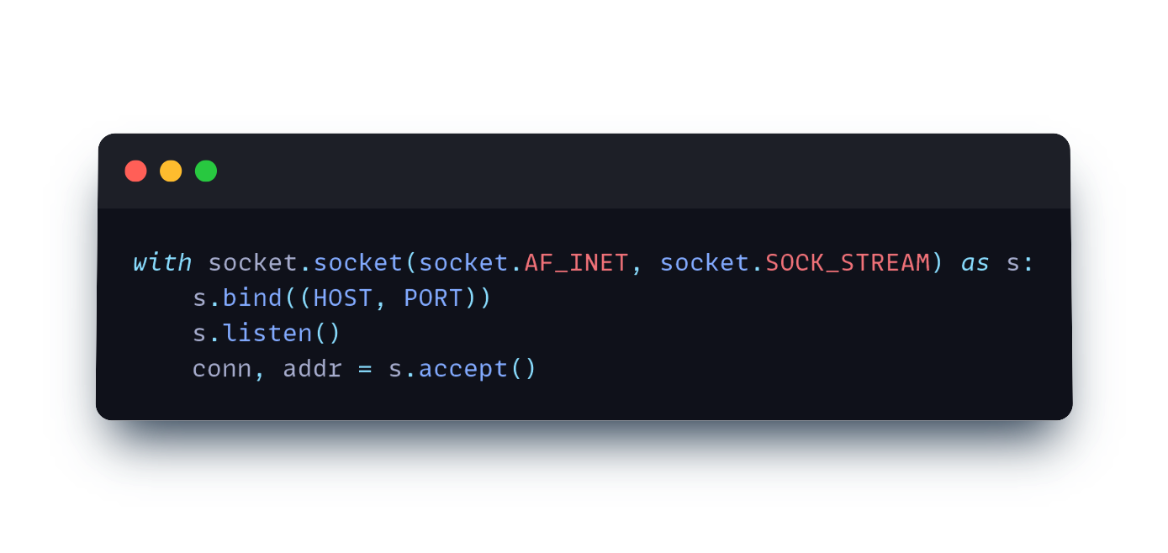
TCP Server Example
CS408 – Computer Networks

Slide 8
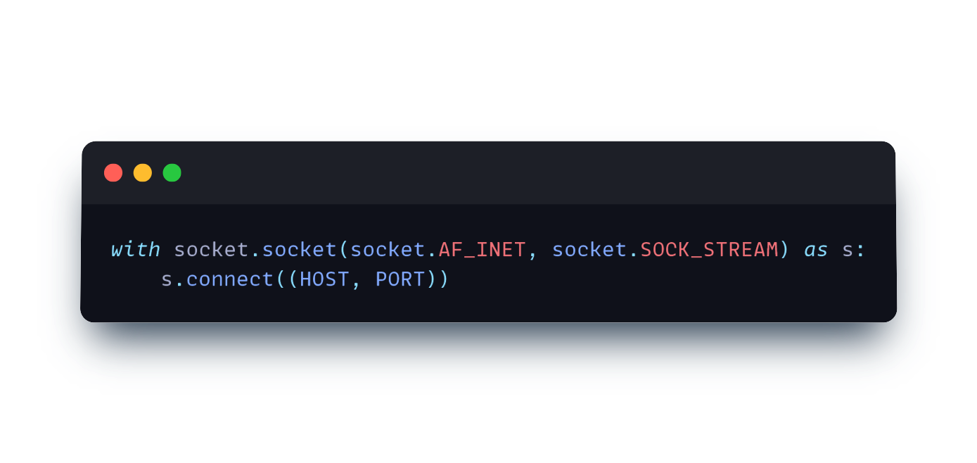
TCP Client Example
CS408 – Computer Networks

Slide 9
Socket API in Python
.socket() - Creates a socket
.bind() - Binds socket to an interface and port
.listen() - Listens incoming connections
.accept() - Accepts incoming connections
.connect() - Connects to a socket
.send() - Sends data
.recv() - Receives data
.sendall() - Sends all data
.close() - Closes socket / connetion
CS408 – Computer Networks

Slide 10
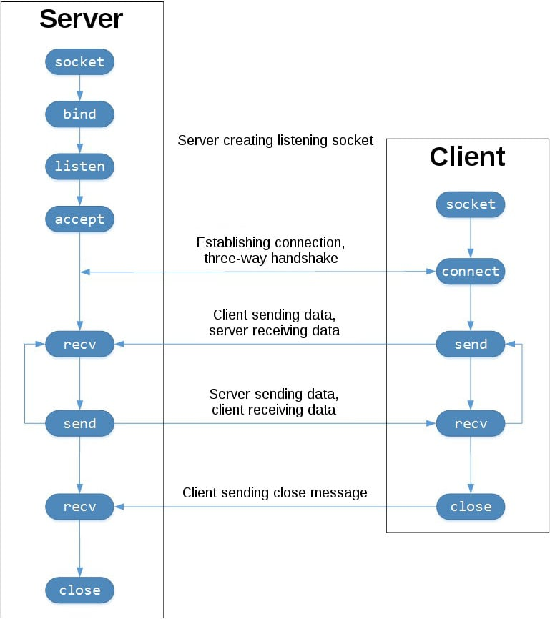
A typical client-server communication from a socket perspective
CS408 – Computer Networks

Slide 11
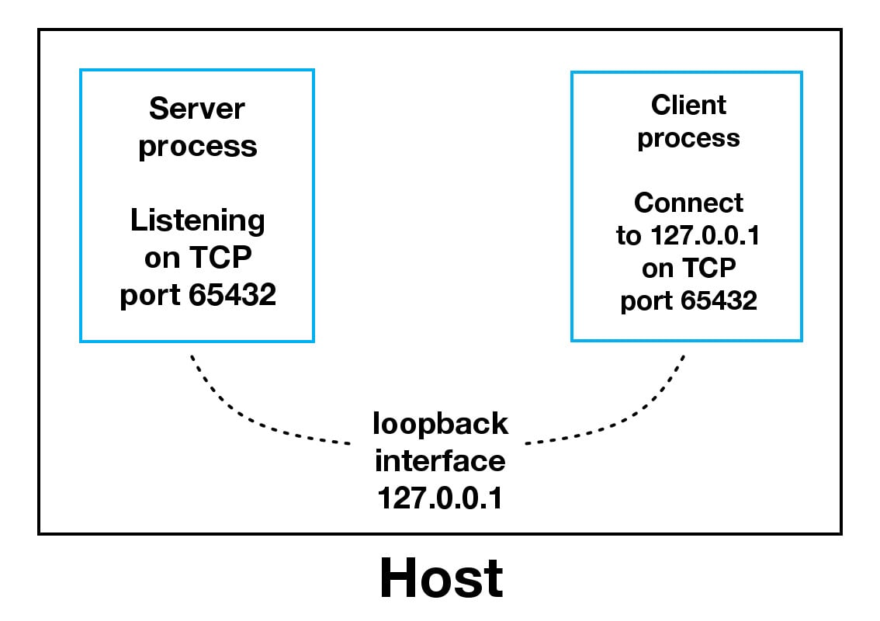

Slide 12
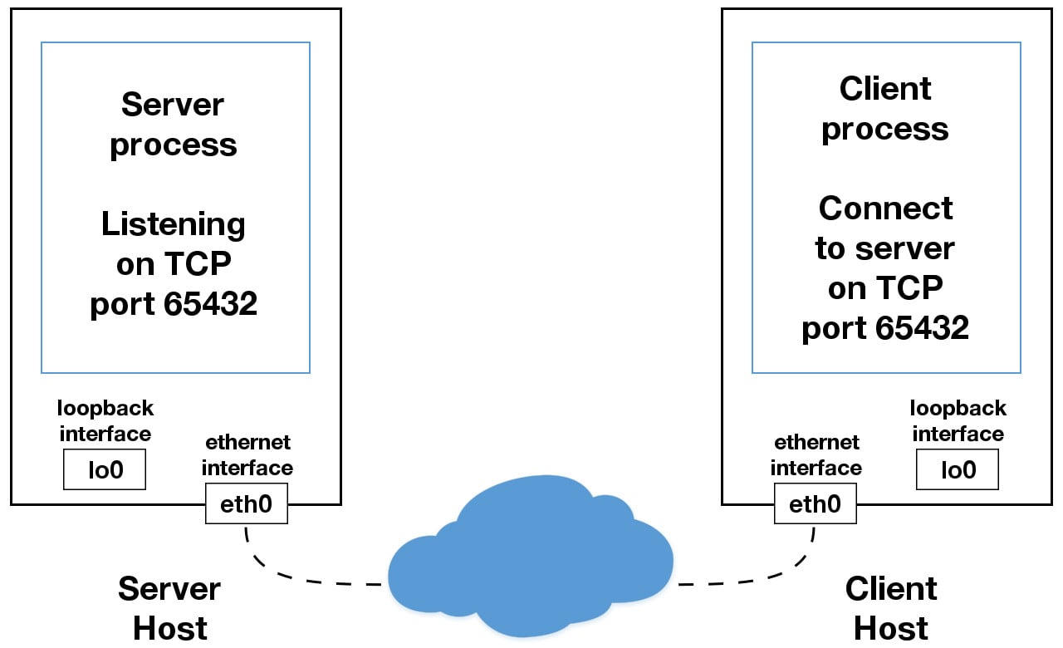

Slide 13

Questions
CS408 – Computer Networks

